Slide 1
Individual Homework
Dan Alexandru

Slide 2
Problem statement: Write all the anti-models of the propositional formula U2 = q ∧ ¬p ∧ r → ¬p ∨ ¬(q ∧ r) using the semantic tableaux method.

Slide 3
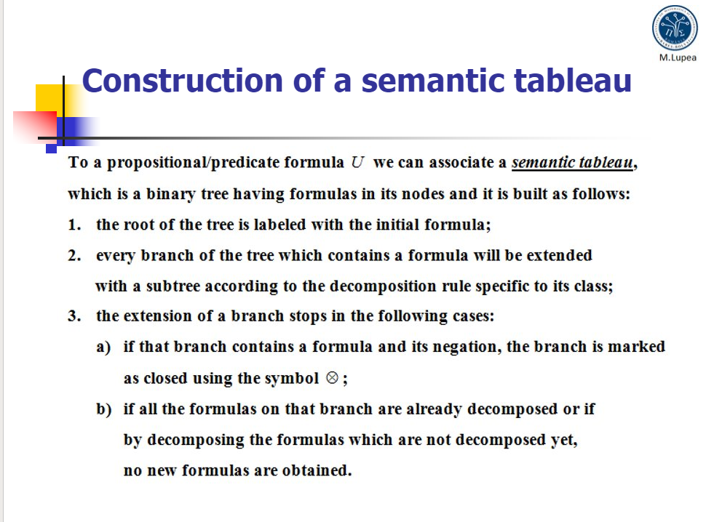
Theoretical results

Slide 4
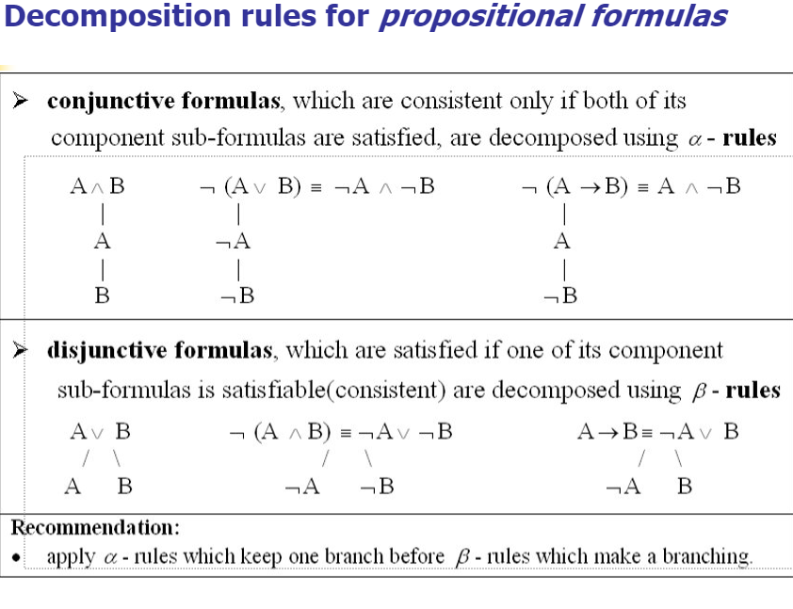

Slide 5
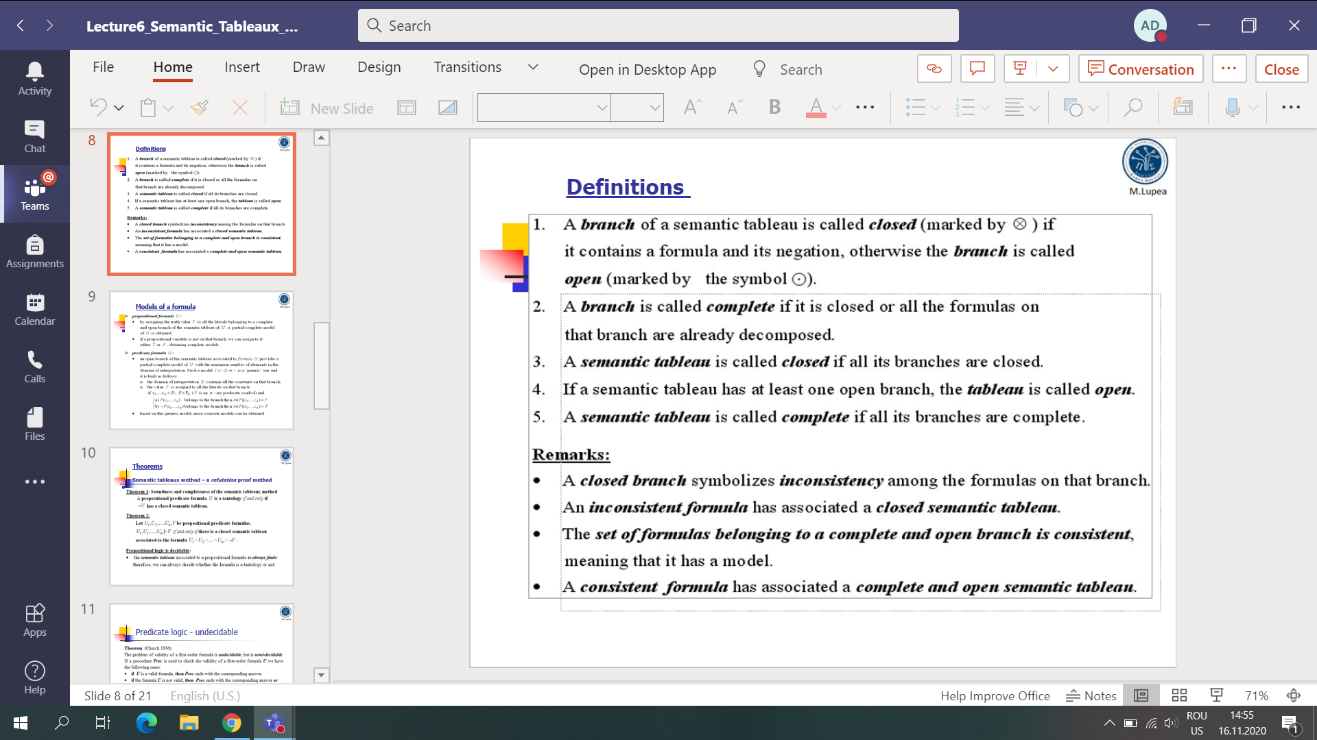
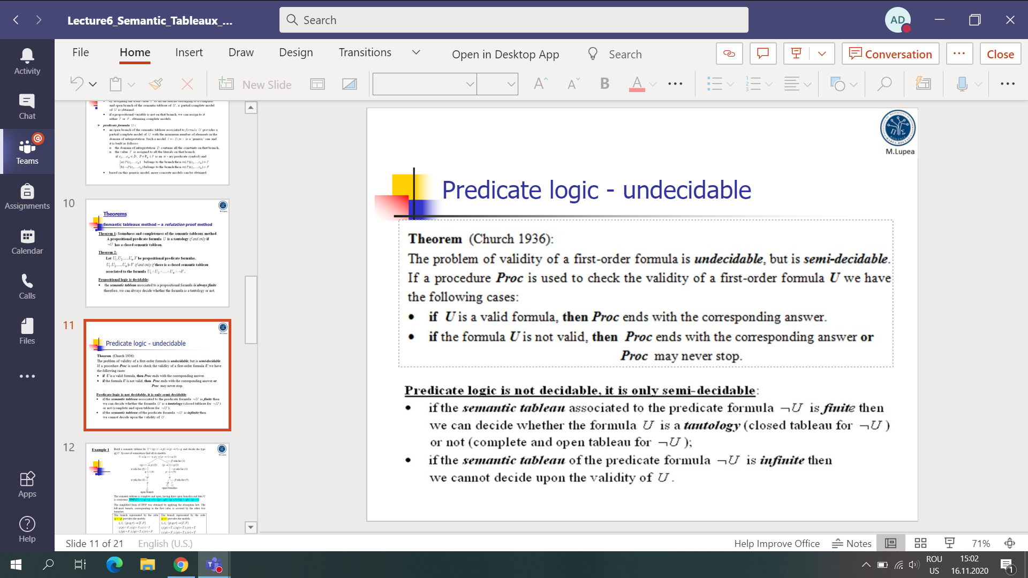
Theoretical statements

Slide 6
Semantic tableau associated to ¬U2
¬U2 ≡ q ∧ ¬p ∧ r ∧ p ∧ q ∧ r ≡ q ∧ r ∧ p ∧ ¬p(1)
α rule for (1)
q
r
p
¬p
..

Slide 7
Conclusion
The semantic tableau associated to the ¬U2 formula is finite and closed so U2 is a tautology and has no anti-models!

Slide 8


